Slide 1
Software Engineering
Lecture-2

Slide 2
What is Software Process?
When building a Product, it is important to go through a series of predictable steps, road map, that help you create a timely, and high-quality result.
The ROAD MAP that you follow is the Software Process.

Slide 3
Software Process
Software processes are adapted to meet the needs of software engineers and managers as they undertake the development of a software product.
A software process provides a framework for managing activities that can very easily get out of control.
Different types of projects require different software processes.
The software engineer's work products (programs, documentation, data) are produced as a consequence of the activities defined by the software process.
The best indicators of how well a software process has worked are the quality, timeliness, and long-term viability of the resulting software product.

Slide 4
Process Characteristics
Prescribes all major process activities
Uses resources with constraints
Produces intermediate and final products
May be composed of sub-processes
Has entry and exit criteria
Is organized in a sequence
Has a set of guiding principles to explain process goals

Slide 5
Software Engineering Phases
Definition Phase – What
Development Phase – How
Maintenance Phase – Change

Slide 6
Definition (What???)
System or information engineering
Software project planning
Requirements analysis
Notes:
Addresses the questions of the:
- information to be processed
- functions desired
- performance desired
- interfaces
- validation criteria
- behavior of the system

Slide 7
Development (How???)
Software design
Code Generation
Software Testing
Notes:
- how the data is structured
- how functions are implemented as a software architecture
- how procedural details are to be implemented
- how interfaces are to be implemented
- how design will be translated to programming language
- how the above will be tested

Slide 8
Maintenance (Change)
Correction
Adaptation
Enhancement
Prevention
Notes:
1.Corrective maintenance corrects the defects found in the software.
2. Adaptive maintenance provides for changes needed to accommodate changes in the environment
3. Perfective maintenance extends software performance beyond original requirements
4. Preventive maintenance (software reengineering); changes that make programs easier to correct, adapt or enhance

Slide 9
Process in S.E
Software engineering encompasses a process, management techniques, technical methods, and the use of tools.
Major goals of software engineering are to :
  deliver project on time
  within budget
  Having required quality
  Satisfying the true needs of stakeholders

Slide 10
A Layered Technology
Software Engineering
tools
methods
process model
a “quality” focus

Slide 11
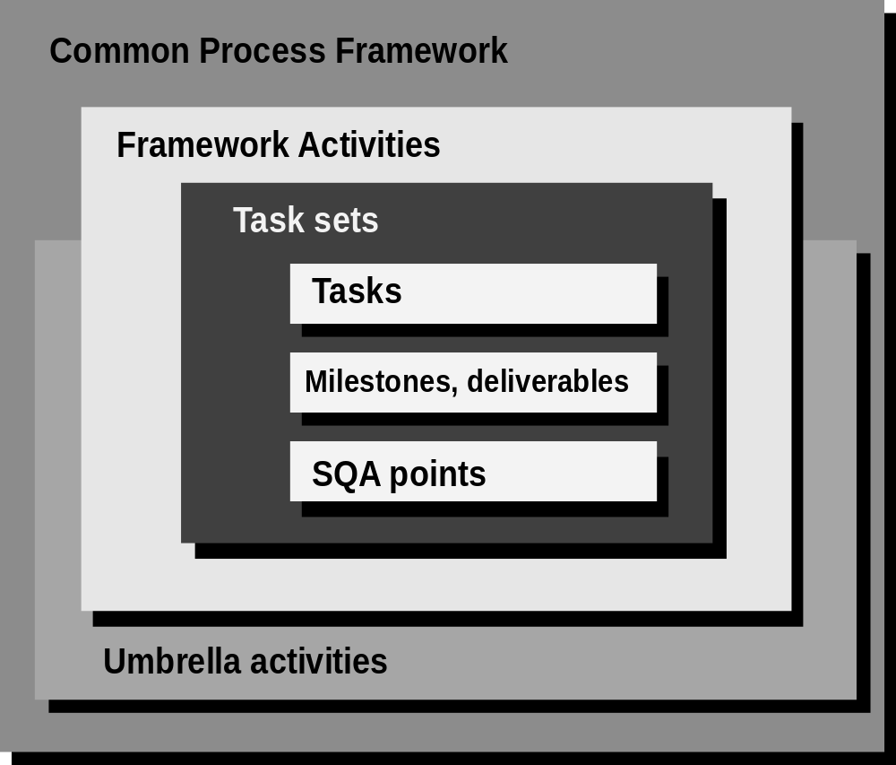
A Common Process Framework
Notes:
Task sets activities are unique for each project and umbrella activities are performed for all projects and are fairly equal in different projects.

Slide 12
Framework Activities
Communication
  Customer collaboration, Requirement gathering
Planning
  work plan, technical risks, resource requirements, work products produced, and work schedule
Modeling
  Analysis of requirements, Design
Construction
  Code generation, Testing
Deployment
  software delivered for customer evaluation and feedback

Slide 13
Umbrella Activities
Software project management
  Tracking and control
Formal technical reviews
  Assess engineering work products to uncover and remove errors before they propagate to next activity
Software quality assurance
  Maintain software quality
Software configuration management
  Manage effects of change

Slide 14
Umbrella Activities contd…
Work product preparation and production
  Create models, documents, logs, forms, lists, etc.
Reusability management
  Define criteria for work product reuse and establish mechanisms to achieve component reuse
Measurement
  Define and collect process, project, and product measures
Risk management
  Assess risks that may affect project outcomes or quality

Slide 15
Why Software Projects Fail?
Unrealistic plans, based on optimistic estimates
Ineffective tracking of performance
Volatile requirements
Risks
Notes:
SEI started from the hypothesis that the difficulties in project management in SW projects depends more on the human nature than in the intrinsic difficulty in software development.
They identified four areas that caused SW projects to fail. (according to the research up until 1994, this was the case in 75% of organizations that develop software)
Projects are estimated and planned intuitively, rather than based on numbers. There is a lot of “hunches”, “best case” optimizations, and “scary” stuff.

Slide 16
But, Why do We Let it Happen?
People are unduly optimistic in their plans and forecasts
People prefer to use intuitive judgment rather than quantitative models
Notes:
Research shows that there are some systematic biases in the human nature.
1. Avoiding risk: (1) society marks winners and looser, so people don’t like to lose; (2) society values taking risks, but not gambling (taking risks that turn out badly)
According to the research, decisions should be made to maximize expected value (theory of probability and statistics). However, people tend to chose safer approach.
CMM recognizes this problem and suggests that risks should be dealt with an organizational level, rather than on the individual level.
2. People tend to be overly optimistic about what they can do; This results in unrealistic evaluations of progress, unrealistic plans, illusion of control
CMM takes position that SW engineering is a “manageable” process, and advocates the evolving approach to increasing the performance of the SW development process.
3. People tend to rely on intuitive judgment, rather than on numerical characterization
CMM suggests using models:
- simple models based on the statistics are more accurate than intuitive judgments
- even when human judges are used, greater accuracy is achieved
- optimal weighting of variables

Slide 17
How to avoid?
Document the way work is performed
Provide guidance and quantifiable criteria where possible
Record decisions and the data used to make them
Analyze the results and improve the process where possible
Learn - individually and organizationally
Notes:
Research also show that people tend to optimize what is measured… this means that within an organized and guided structure or process (change) people will tend to overcome the basic biases in their nature described earlier.
SEI defined CMM to guide organizations to optimizing of their processes. They identified five basic areas critical for providing “a measured environment” for software development.
Note: the idea is not to penalize people for their flaws, experience or education, but to help them and the organization move to the higher level of performance.

Slide 18
Process Assessment
The process should be assessed to ensure that it meets a set of basic process criteria that have been shown to be essential for a successful software engineering.
Many different assessment options are available:
  SCAMPI
  CBA IPI
  SPICE
  ISO 9001:2000

Slide 19
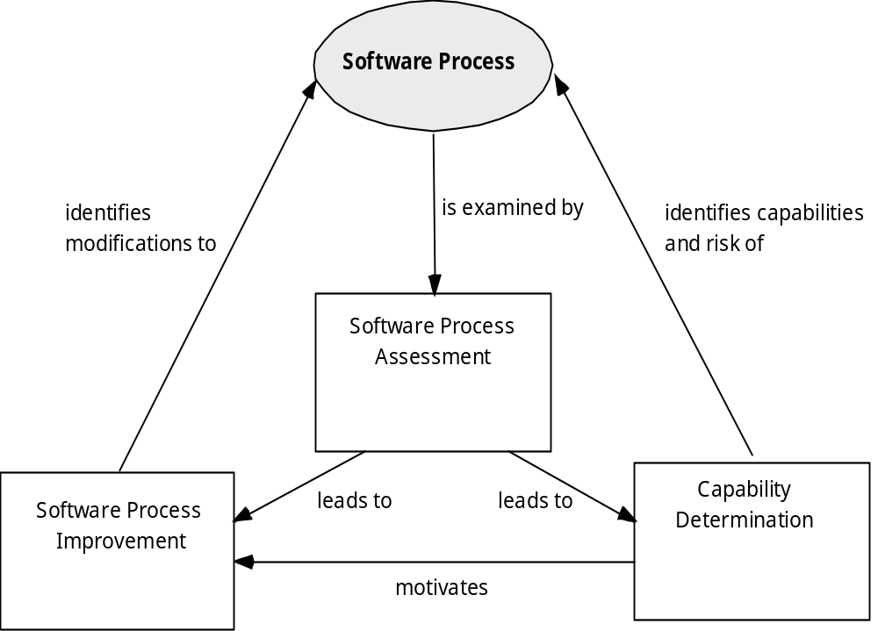
Assessment and Improvement

Slide 20
The Primary Goal of Any Software Process: High Quality
Remember:
High quality = project timeliness
Why?
Less rework!

Slide 21
Variety of Software Processes
Software products are very varied...
Therefore, there is no standard process for all software engineering projects
BUT successful software development projects all need to address similar issues.
This creates a number of process steps that must be part of all software projects

Slide 22
Basic Process Steps in all Software Development
• Feasibility and planning
• Requirements
• System and program design
• Implementation and testing
• Deployment and release
• Operation and maintenance
Also known as Software Development Life Cycle (SDLC).

Slide 23
Feasibility and Planning
A feasibility study precedes the decision to begin a project.
• What is the scope of the proposed project?
• Is the project technically feasible?
• What are the projected benefits?
• What are the costs, timetable?
A feasibility study leads to a decision: go or no-go.

Slide 24
Requirements
Requirements define the function of the system from the client's viewpoint.
The requirements establish the system's functionality, constraints and goals by consultation with the client and users. They are then defined in a manner that is understandable by both the client and the development staff.
This phase is sometimes divided into:
Requirements analysis
Requirements definition
Requirements specification

Slide 25
System and Program Design
Design describes the system from the software developers' viewpoint
System design: Match the requirements to hardware or software systems. Establishes an overall system architecture
Program design: Represent the software system functions in a form that can be transformed into one or more executable programs
Unified Modeling Language (UML)

Slide 26
Implementation and Testing
Implementation (coding)
The software design is realized as a set of programs or program units.
Testing
Individual components are tested against specifications.
The individual program units are integrated and tested against the design by the development staff as a complete system.

Slide 27
Deployment and Release
Deployment and release
The complete system is delivered to the client and released into production.

Slide 28
Operation and Maintenance
Operation: The system is put into practical use.
Maintenance: Errors and problems are identified and fixed.
Evolution: The system evolves over time as requirements change, to add new functions or adapt the technical environment.

